Slide 1
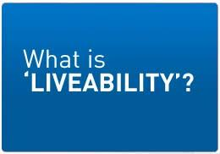
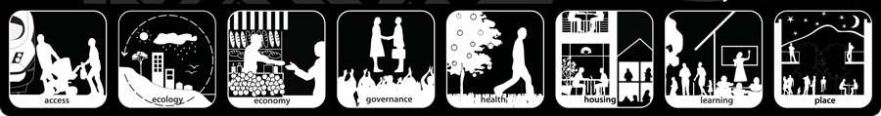
Lesson 6

Slide 2
Changing Population Distribution in Australia

Slide 3
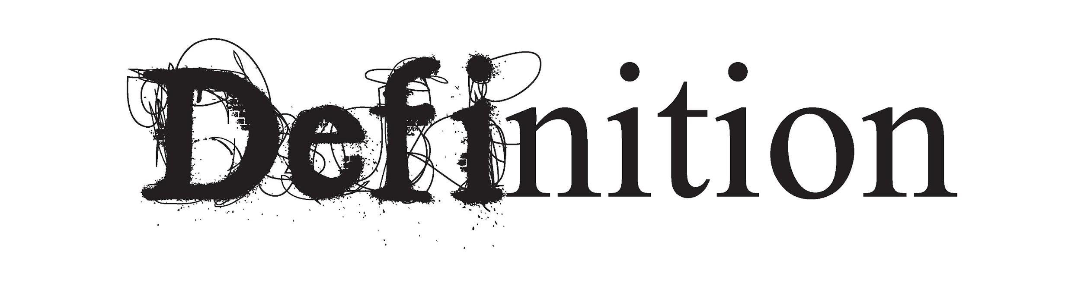
Population density is the average number of people per square kilometre. It is a way of measuring population distribution and shows whether an area is sparsely or densely populated.

Slide 4
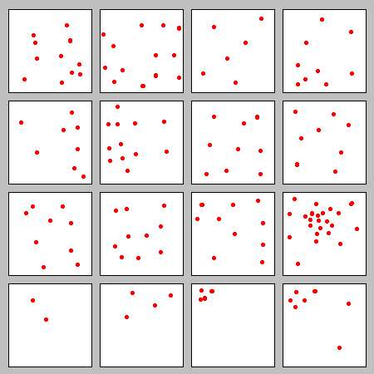

Slide 5
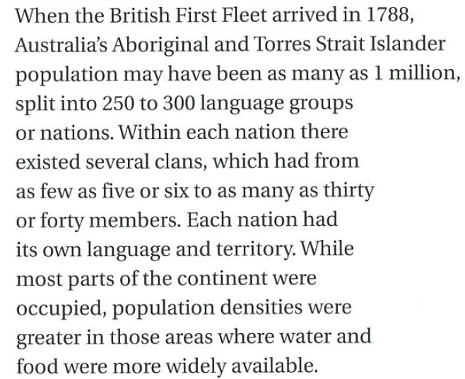

Pre-1788

Slide 6
Pre-1788

Slide 7
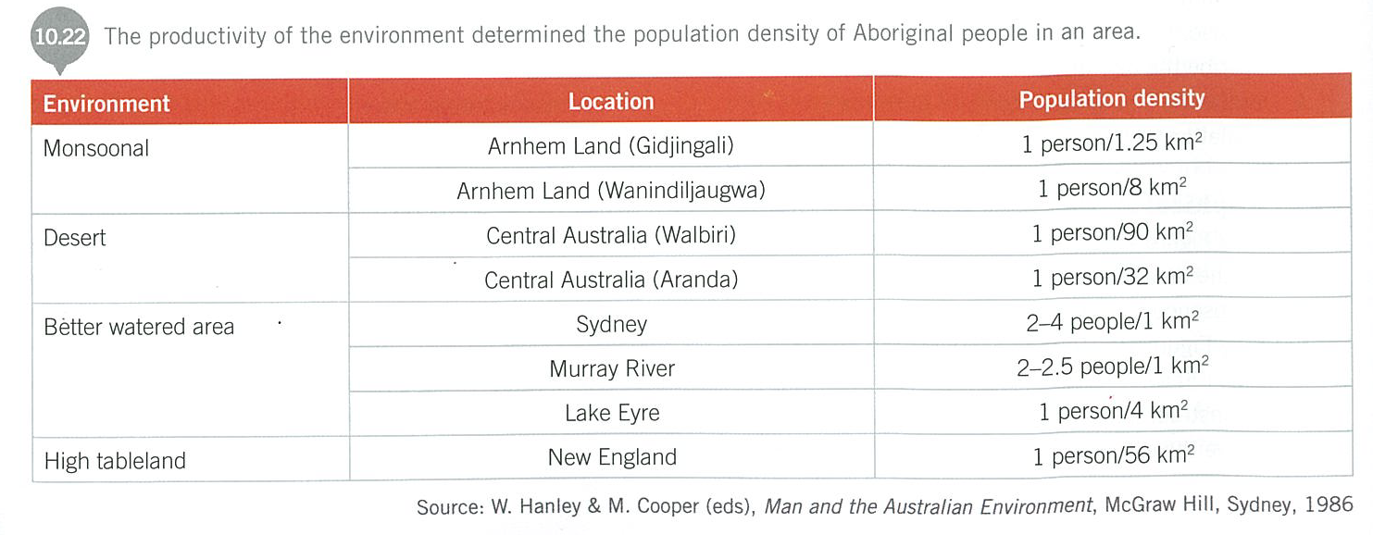

Slide 8
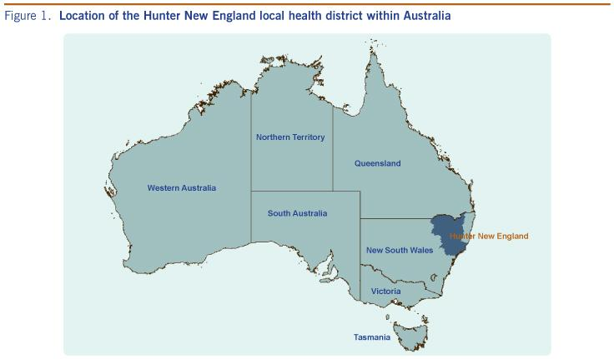
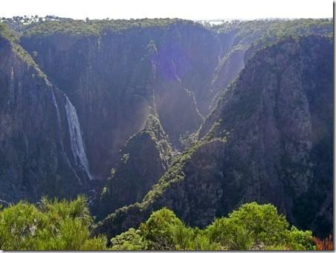

Slide 9
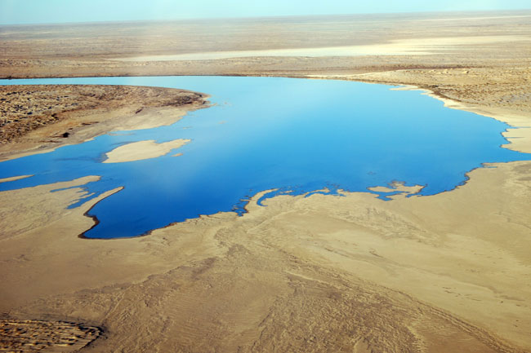
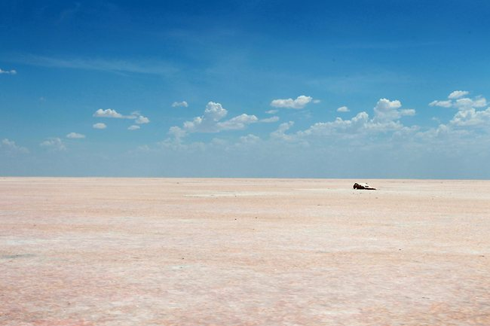

Slide 10
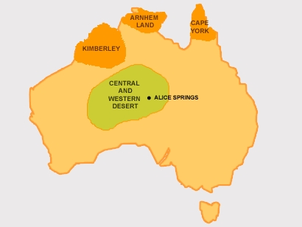
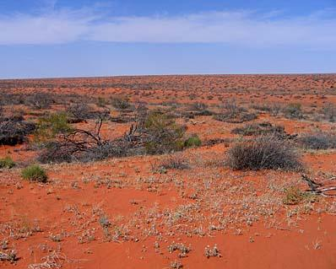

Slide 11
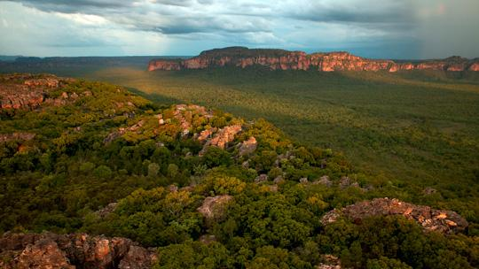
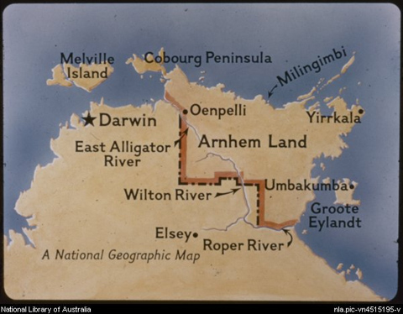

Slide 12
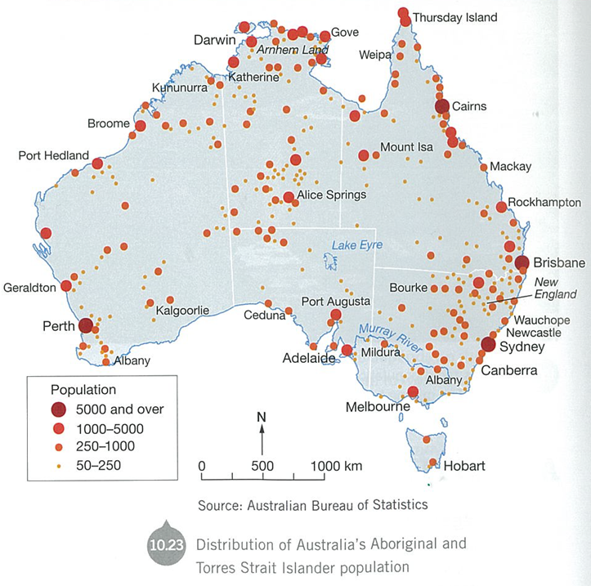
26% of Indigenous Australians live in semi-remote and remote areas.

Slide 13
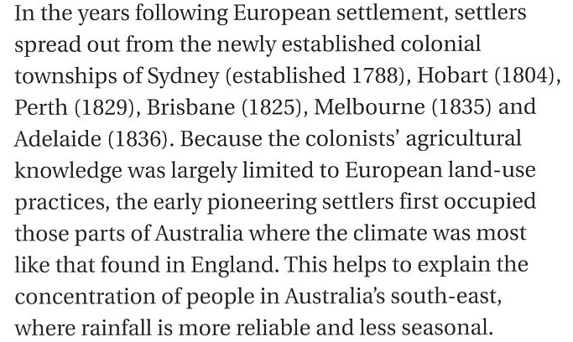
Post-1788

Slide 14
Post-1788

Slide 15
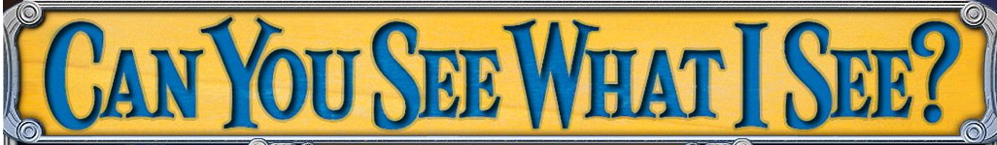
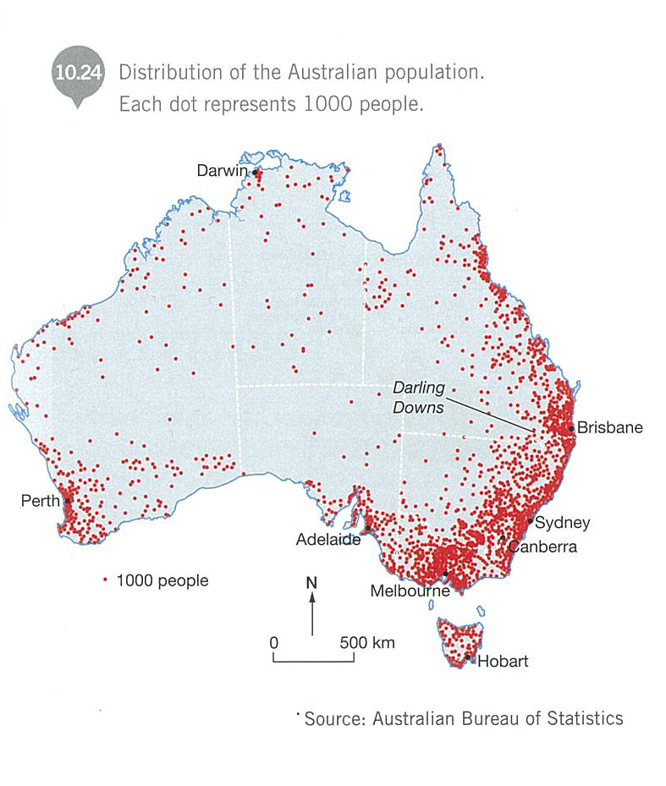

Slide 16

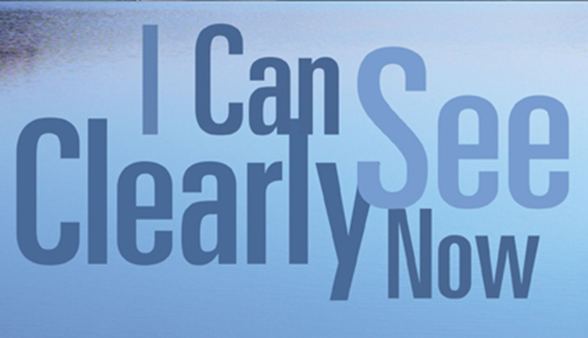
Uneven distribution
Narrow strip from Brisbane to Adelaide
81% of the continent contains just 3% of population
80% of people live there in 3% of land’s area
Moderate population from Darling Downs, through central west NSW and across Victoria

Slide 17


Slide 18
Add a title

Slide 19
Shade in the areas along the coast with high population density

Slide 20
Why do so many people live here?

Slide 21
High density

Slide 22
Moderate density
High density

Slide 23
Sparse density
Moderate density
High density

Slide 24
Lesson 7

Slide 25
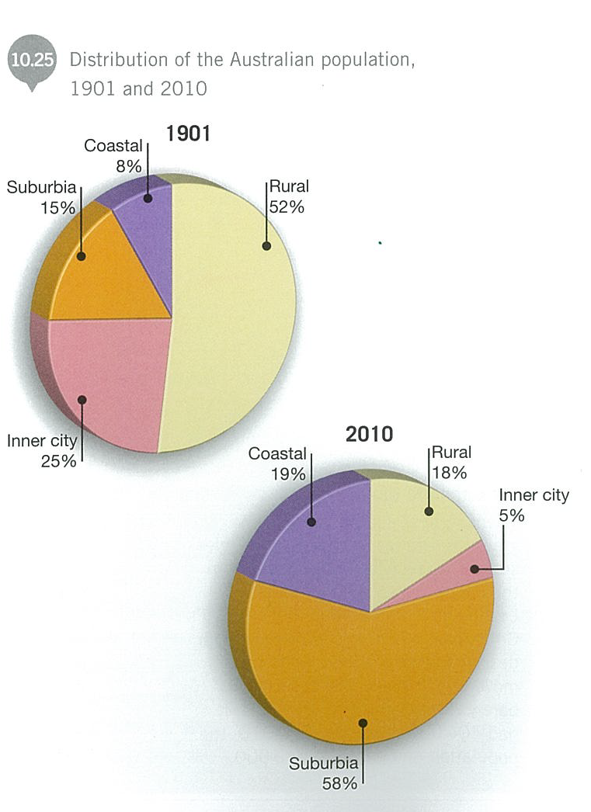
Draw the
pie charts

Slide 26
Write a brief comparison &
explanation

Slide 27
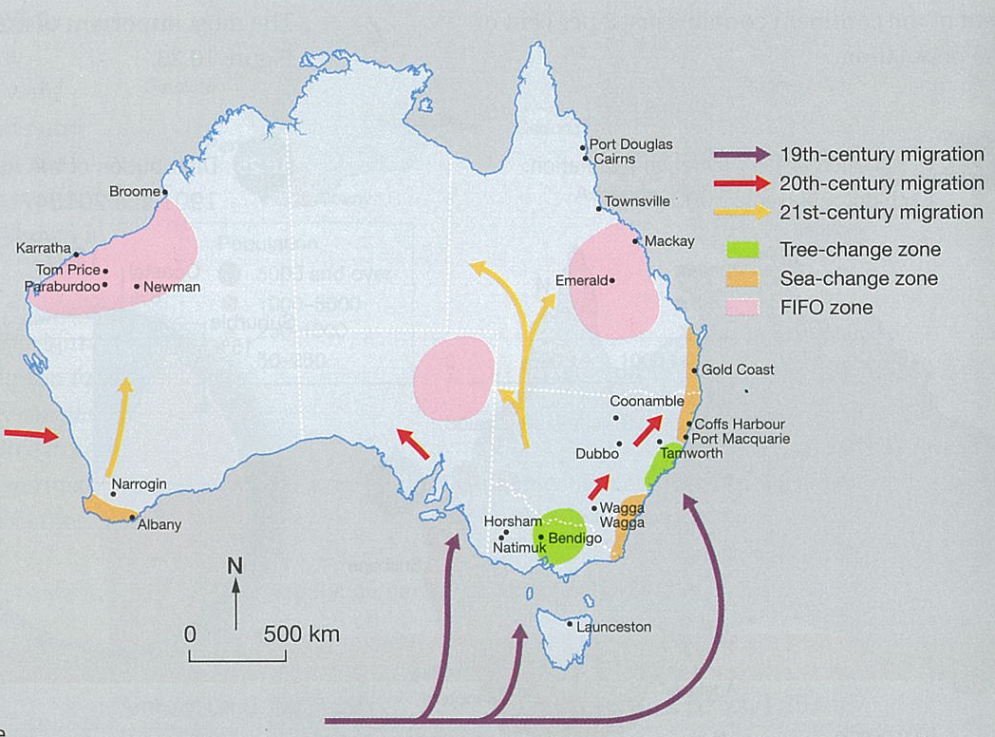
Copy

Slide 28
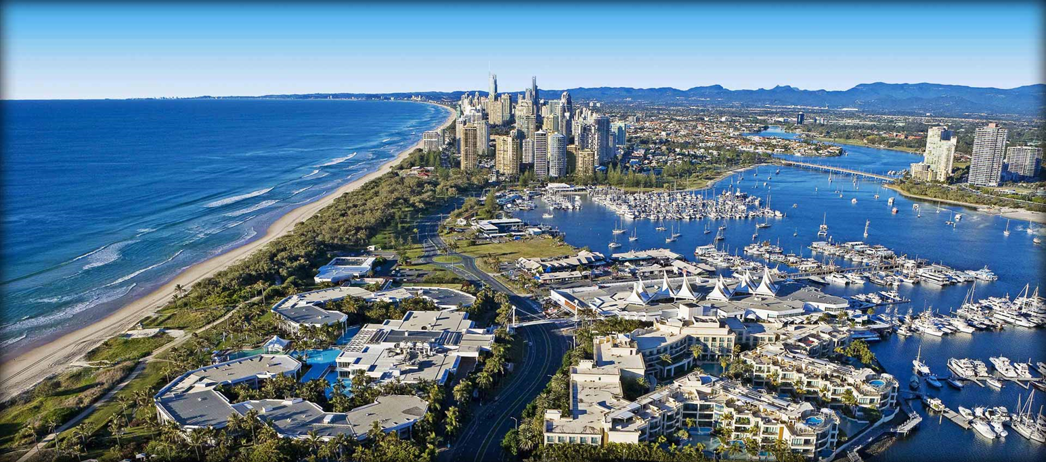
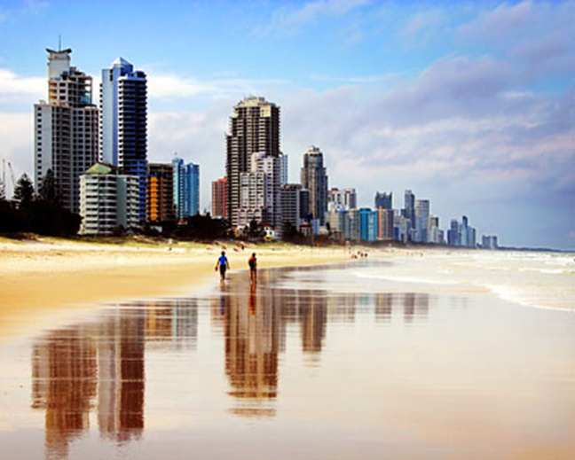
Towns along coast have grown – retirees, singles and families seeking a lifestyle change
Gold Coast most popular destination for 20 years. In 2000 = 404,000 res In 2010 = 540,000 res
Sea Change

Slide 29
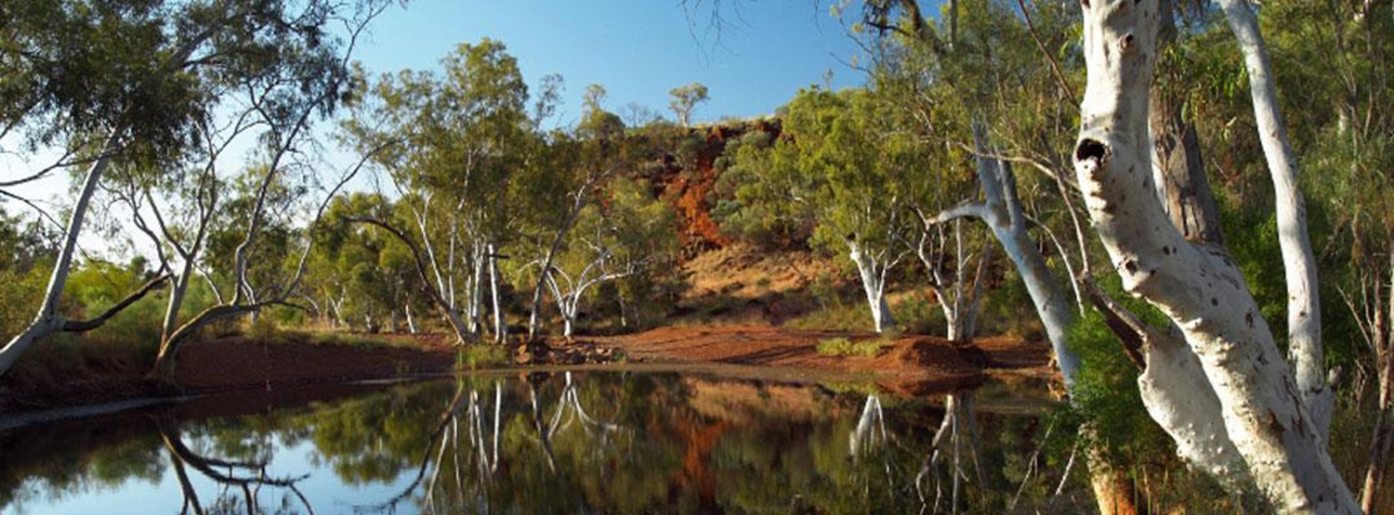
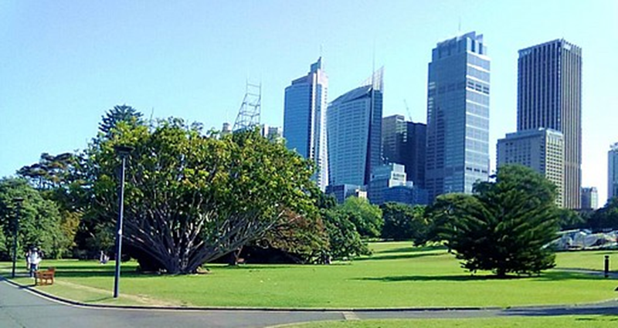
Cities such as Tamworth, Wagga Wagga and Narrogin have grown
Soaking up people from smaller, surrounding rural areas.
Tree Change

Slide 30
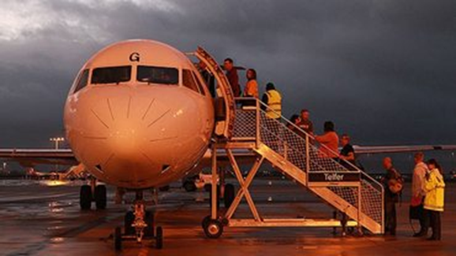
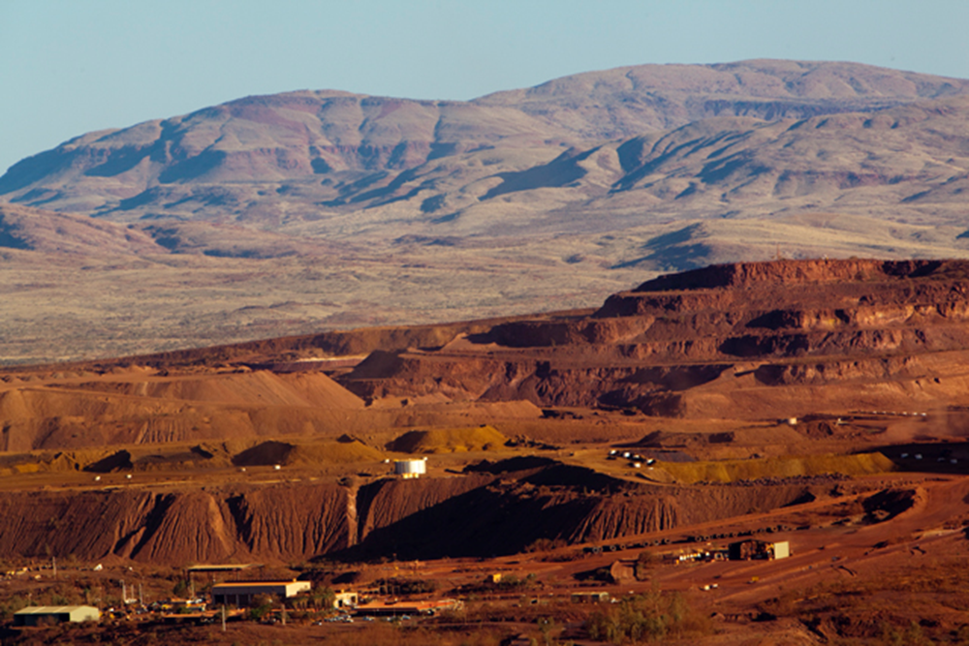
Mining boom is attracting people to mineral rich areas of Aus.
FIFO & DIDO means that growth in these areas might not be as great as in earlier booms

Slide 31

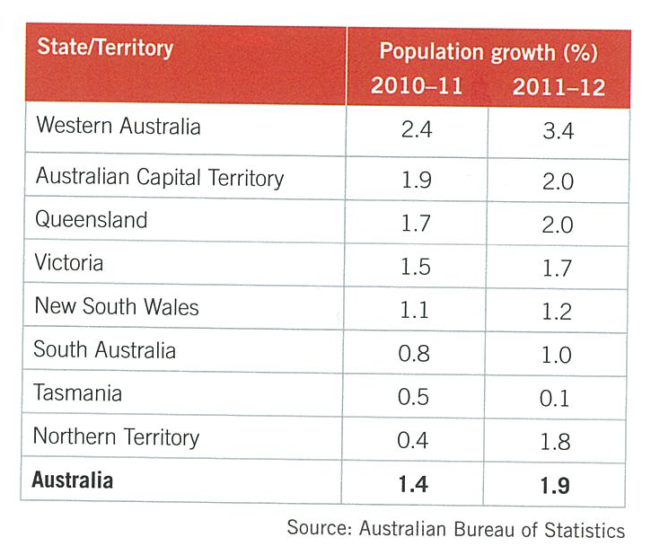

Slide 32
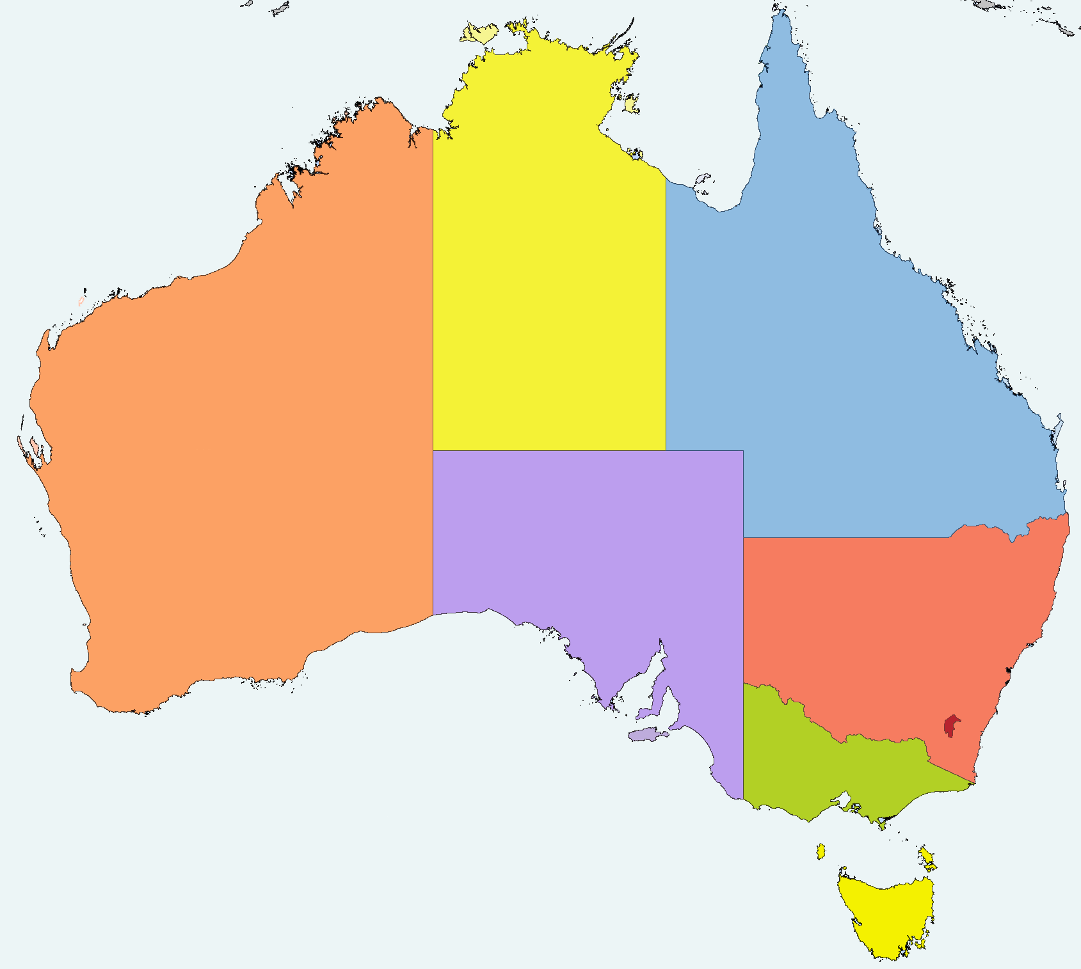
Overseas Migration 2010-11
630
31,300
50,200
45,700

Slide 33
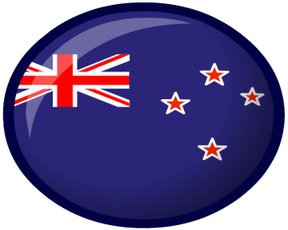

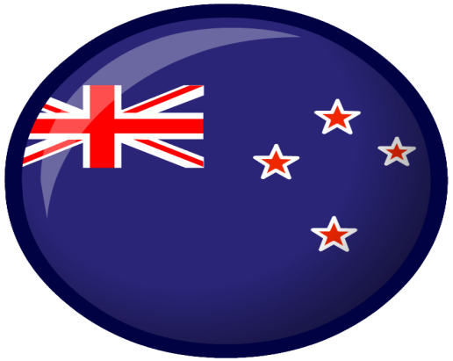

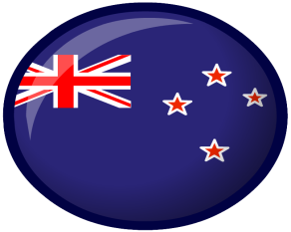


570,000
New Zealanders

